Slide 1
Computer Network (18CSC302J)
Hospital Network Design
Shubham Kumar (RA2011026010090)
Roopal Sood (RA2011026010103)
Sayak Das(RA20110260101)
Parth Madan (RA2011026010114)

Slide 2
Introduction
A hospital network design is created using tools like cisco packet tracer. Hospital will have a main block and three wards in the campus. The main block will have 3 floor and the registration of all the new patients will be done here. At the ground floor, there are 10 computers at the billing section. At other floors, there is one computer user each. The farthest distance between the computer on the top most floor and the ground floor is less than 70 meters. The wards have 3 floors each, with 5 computers in the ground floor of each ward.

Slide 3
ABSTRACT
This report describes the network design of Health care management or Hospital. In this network topology the nodes (i.e., computers, switches, routers or other devices) are connected to a local area network (LAN) and network via links (twisted pair copper wire cable or optical fiber cable). We have used Cisco Packet Tracer for designing the network topology It’s a general design which can be implemented at any higher level to manage network system.

Slide 4
NETWORK REQUIREMENTS
In Health care Network topology, we have desktop Computer, laptops, smart phone. There is a data flow between the devices within the system. We have divided our network into segments like for Hospital wards, clinical area etc. We have also used SSH for security. Our network requirements include network devices like routers, switches, server.

Slide 5
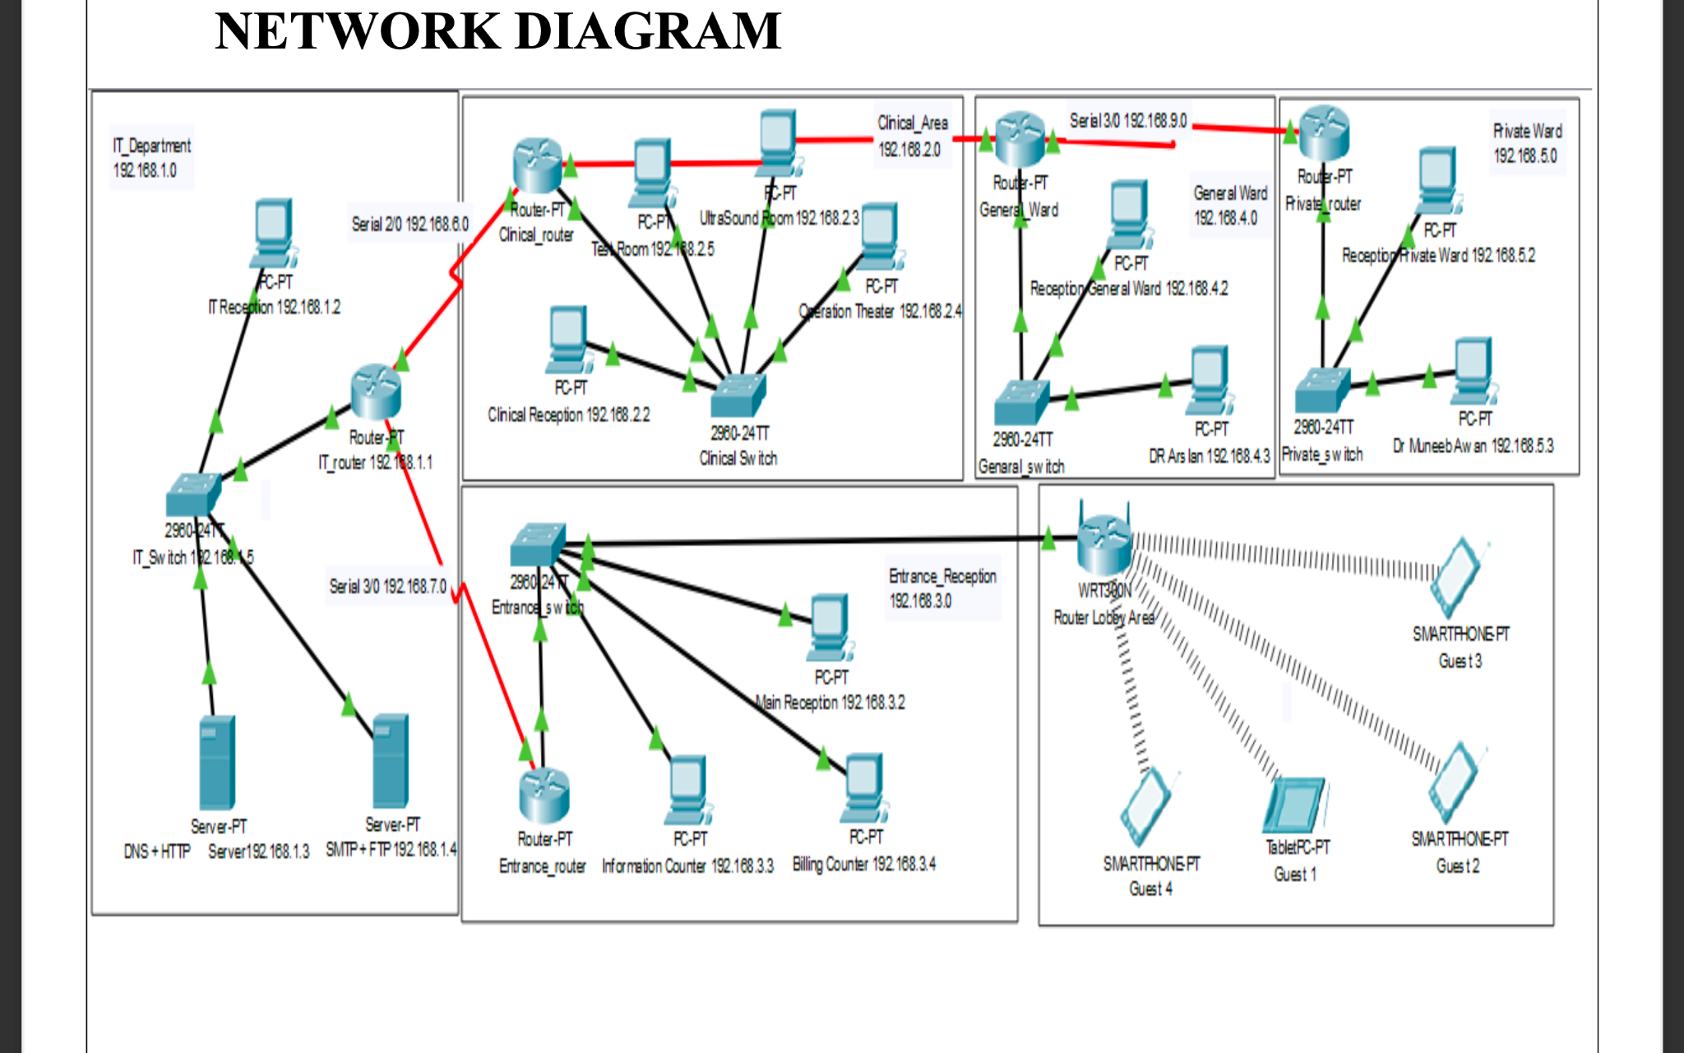
Design of network in hospital

Slide 6
Calculation and Implementation
We have divided the hospital network diagram into 6 segments.
General Ward
Private Ward
Clinical Area
IT Department
Entrance Reception
Lobby Parking

Slide 7
Calculation and Implementation
COST OF NETWORK Cisco Switch
250$ Each
1250$ Cost of 5 Switch
Cisco Router
350$ Each
2100$ Cost of 6 Router
Cisco Server
400$ Each
800$ Cost of 2 Server
Computer Cost
125$ Each
1500$ Cost of 12 Computer
Total Cost = 5650$

Slide 8
DEFINITIONS
- DHCP
The Dynamic Host Configuration Protocol (DHCP) is a network management protocol used on UDP/IP networks whereby a DHCP server dynamically assigns an IP address and other network configuration parameters to each device on a network so they can communicate with other IP networks.
- DNS
The Domain Name System is a hierarchical and decentralized naming system for computers, services, or other resources connected to the Internet or a private network.
- SUBNETTING
A subnetwork or subnet is a logical subdivision of an IP network. The practice of dividing a network into two or more networks is called subnetting.
- HTTPS
Hypertext Transfer Protocol Secure is an extension of the Hypertext Transfer Protocol. It is used for secure communication over a computer network and is widely used on the Internet. Hypertext Transfer Protocol Secure is an extension of the Hypertext Transfer Protocol. It is used for secure communication over a computer network and is widely used on the Internet.

Slide 9
- SSH
Secure Shell is a cryptographic network protocol for operating network services securely over an unsecured network.
- SMTP
The Simple Mail Transfer Protocol is a communication protocol for electronic mail transmission.
- FTP
The File Transfer Protocol is a standard network protocol used for the transfer of computer files between a client and server on a computer network.
- WIFI
Wi-Fi is the name of a wireless networking technology that uses radio waves to provide wireless high-speed Internet and network connections.

Slide 10
Result
The hospital network has been created successfully in cisco packet tracer and now we can set-up the same network throughout the hospital. Now, we know the estimated cost of complete network set-up.

Slide 11
Conclusion
This report describes how we have designed network topology of hospital (Health care Management System). With VLSM for Subnetting, segmented the diagram into 5 segments. This topology can also be implemented on higher level of hospitals.

Slide 12
Reference
Internet sources:
https://www.techtarget.com/
https://www.youtube.com/c/GateSmashers
https://en.wikipedia.org/wiki/Computer_network
Books:
Computer Networking: A Top-Down Approach

